Slide 1

8th Grade Math: Pre-Algebra
Unit 3, Lesson 3 More with Powers of 10 Volume 1, pg. 92

Slide 2


Benchmark
MA.8.NSO.1.3
Extend previous understanding of the Laws of Exponents to include integer exponents. Apply the Laws of Exponents to evaluate numerical expressions and generate equivalent numerical expressions, limited to integer exponents and rational number bases, with procedural fluency.
volume 1, pg. 92

Slide 3
Integrated Mathematical Thinking and Reasoning Standards
MA.K12.MTR.1.1 Actively participate in effortful learning both individually and collectively.
MA.K12.MTR.3.1 Complete tasks with mathematical fluency.
MA.K12.MTR.4.1 Engage in discussions that reflect on the mathematical thinking of self and others.
MA.K12.MTR.5.1 Use patterns and structure to help understand and connect mathematical concepts.
MA.K12.MTR.6.1 Assess the reasonableness of solutions.
volume 1, pg. 92

Slide 4


Learning Target
I can use the Laws of Exponents to evaluate numerical expressions with a base of $10$ and exponents less than $0$.
volume 1, pg. 92

Slide 5

Warm-Up
volume 1, pg. 93

Slide 6
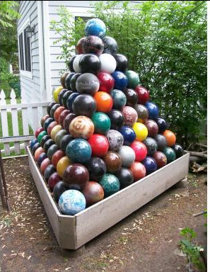
3.3.1 Warm-Up: Notice and Wonder
A picture of a bowling-ball pyramid is shown.
volume 1, pg. 93
Notes:
Video Link: https://algebranation.wistia.com/medias/fi4fidi5y8

Slide 7
What do you wonder?
What do you notice?
Write a question about the pyramid that a 5th grader could answer.
volume 1, pg. 93
Notes:
Video Link: https://algebranation.wistia.com/medias/fi4fidi5y8

Slide 8

Exploration
volume 1, pg. 93

Slide 9
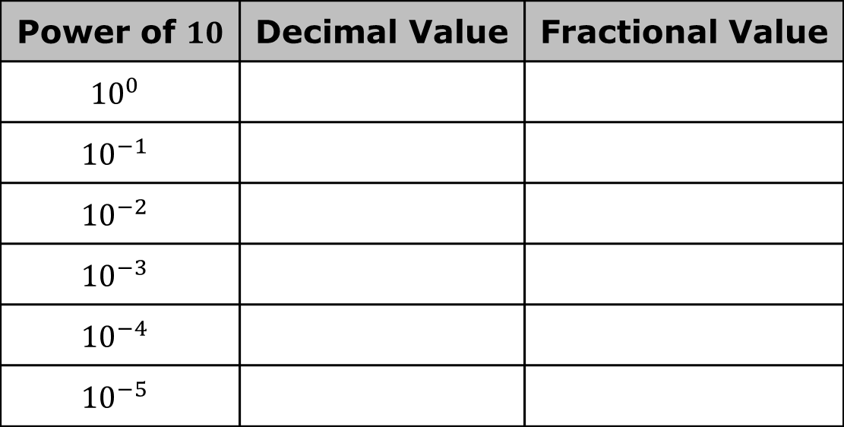
3.3.2 Exploration: Powers of Ten
Use a scientific calculator to find the decimal value of each. Then, write the equivalent fractional value.
Power of $10$ | Decimal Value | Fractional Value
$${10}^{0}$$
$${10}^{−1}$$
$${10}^{−2}$$
$${10}^{−3}$$
$${10}^{−4}$$
$${10}^{−5}$$
volume 1, pg. 93

Slide 10
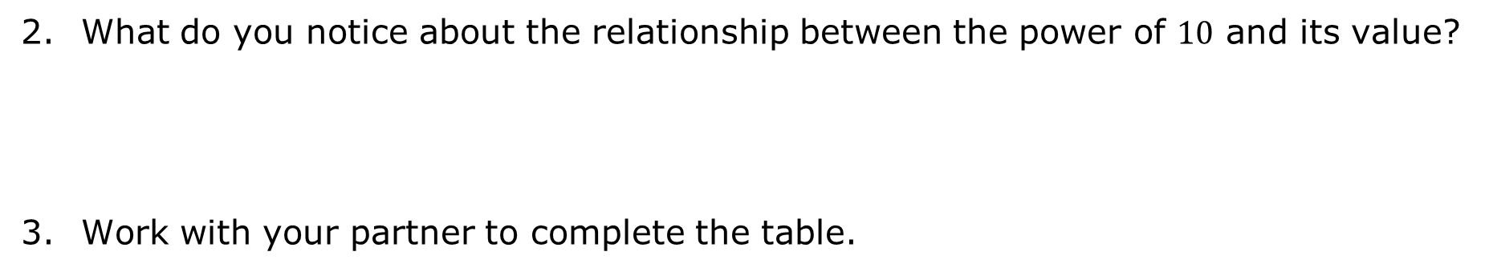
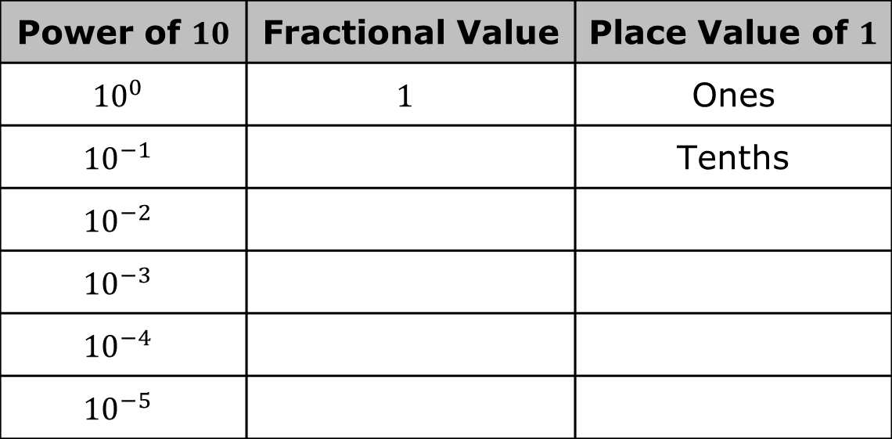
What do you notice about the relationship between the power of $10$ and its value?
Work with your partner to complete the table.
Power of $10$ | Fractional Value | Place Value of $1$
$${10}^{0}$$ | $$1$$ | Ones
$${10}^{−1}$$ |  | Tenths
$${10}^{−2}$$
$${10}^{−3}$$
$${10}^{−4}$$
$${10}^{−5}$$
volume 1, pg. 93

Slide 11

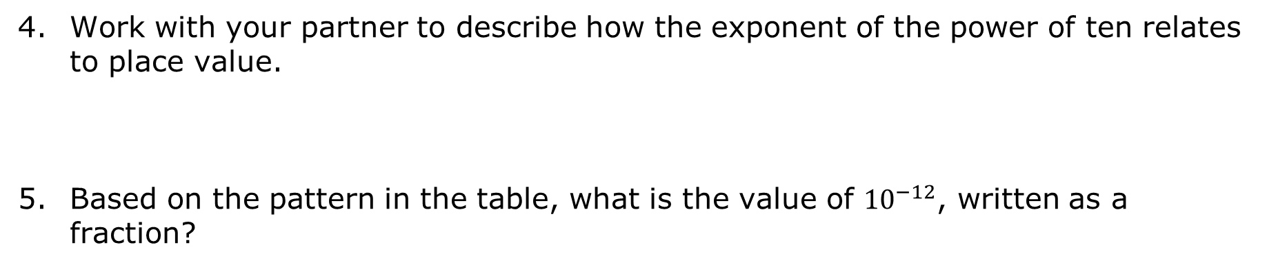
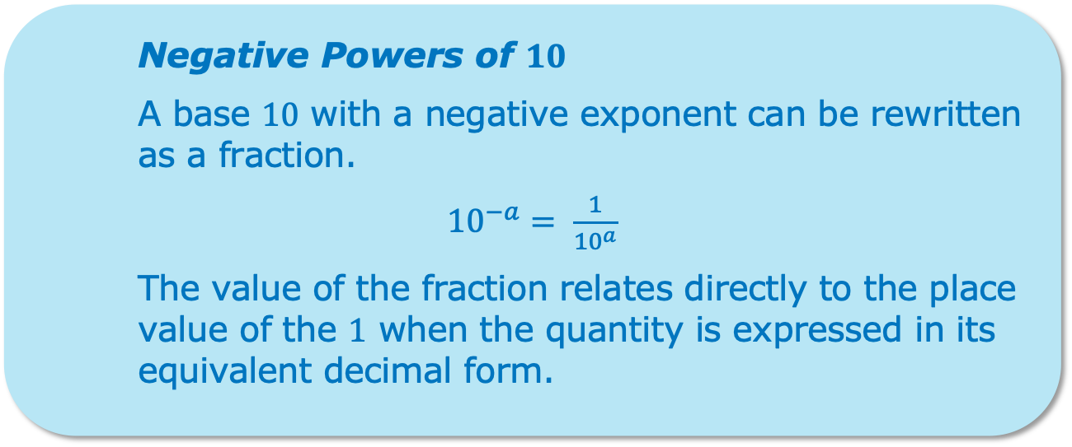
Work with your partner to describe how the exponent of the power of ten relates to place value.
Based on the pattern in the table, what is the value of ${10}^{−12}$, written as a fraction?
Negative Powers of $10$
A base $10$ with a negative exponent can be rewritten as a fraction.
${10}^{−a}= \frac{1}{{10}^{a}}$
The value of the fraction relates directly to the place value of the $1$ when the quantity is expressed in its equivalent decimal form.
volume 1, pg. 94

Slide 12

Try It
volume 1, pg. 94

Slide 13
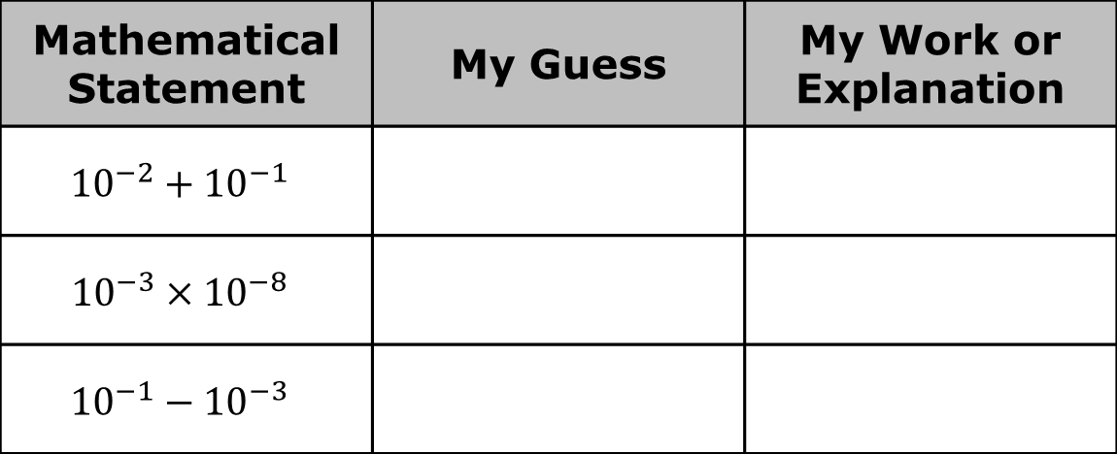
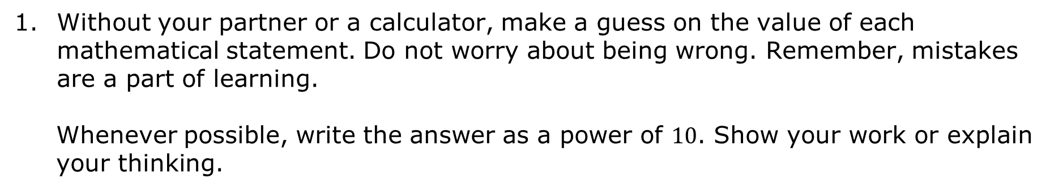
3.3.3 Try It: Make a Guess
Without your partner or a calculator, make a guess on the value of each mathematical statement. Do not worry about being wrong. Remember, mistakes are a part of learning.
Whenever possible, write the answer as a power of $10$. Show your work or explain your thinking.
Mathematical Statement | My Guess | My Work or Explanation
$${10}^{−2}+{10}^{−1}$$
$${10}^{−3}×{10}^{−8}$$
$${10}^{−1}−{10}^{−3}$$
volume 1, pg. 94

Slide 14

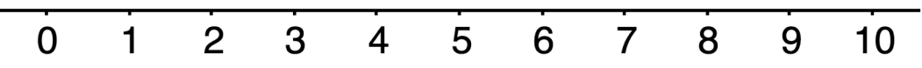
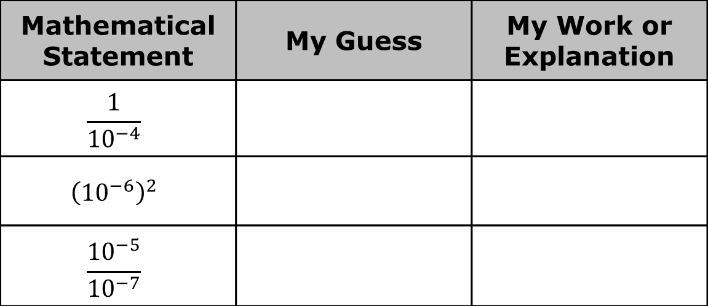
Mathematical Statement | My Guess | My Work or Explanation
$$\frac{1}{{10}^{−4}}$$
$${\left({10}^{−6}\right)}^{2}$$
$$\frac{{10}^{−5}}{{10}^{−7}}$$
How confident are you in your guesses? Use the emoji scale to rate your confidence in your guesses.
volume 1, pg. 94

Slide 15
Exploration
volume 1, pg. 95

Slide 16
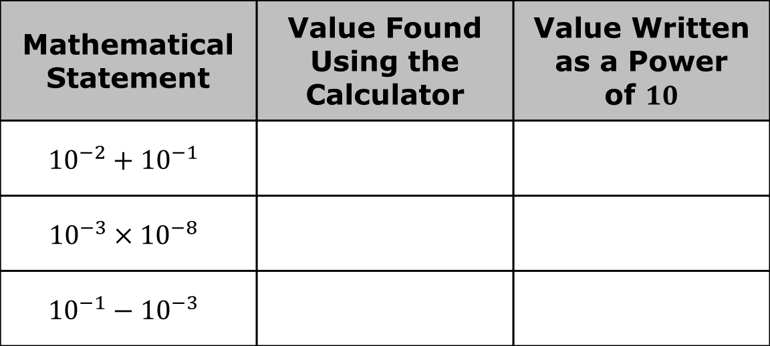
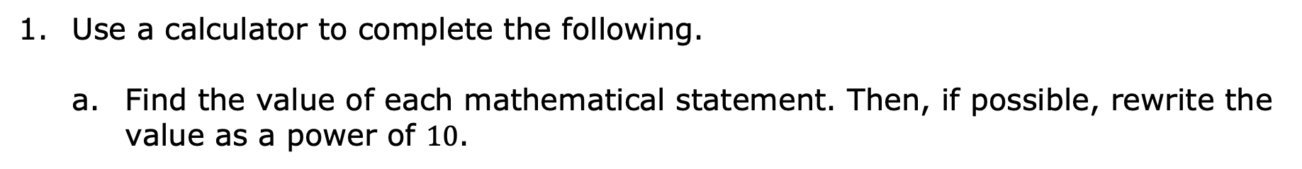
3.3.4 Exploration: Using a Calculator to Check
Use a calculator to complete the following.
Find the value of each mathematical statement. Then, if possible, rewrite the value as a power of $10$.
Mathematical Statement | Value Found Using the Calculator | Value Written as a Power of $10$
$${10}^{−2}+{10}^{−1}$$
$${10}^{−3}×{10}^{−8}$$
$${10}^{−1}−{10}^{−3}$$
volume 1, pg. 95

Slide 17
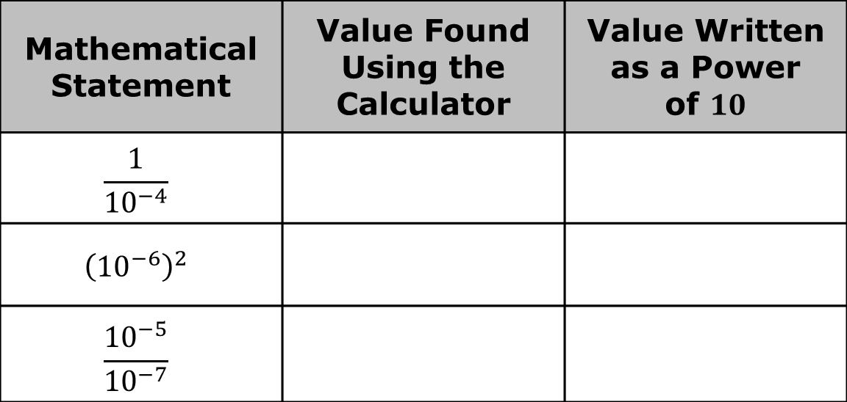

Mathematical Statement | Value Found Using the Calculator | Value Written as a Power of $10$
$$\frac{1}{{10}^{−4}}$$
$${\left({10}^{−6}\right)}^{2}$$
$$\frac{{10}^{−5}}{{10}^{−7}}$$
Compare your earlier guesses to the values you found for each expression, using a calculator.
Discuss with your partner which mathematical statements could be rewritten using a power of $10$ and which could not be. Summarize your findings.
volume 1, pg. 95

Slide 18
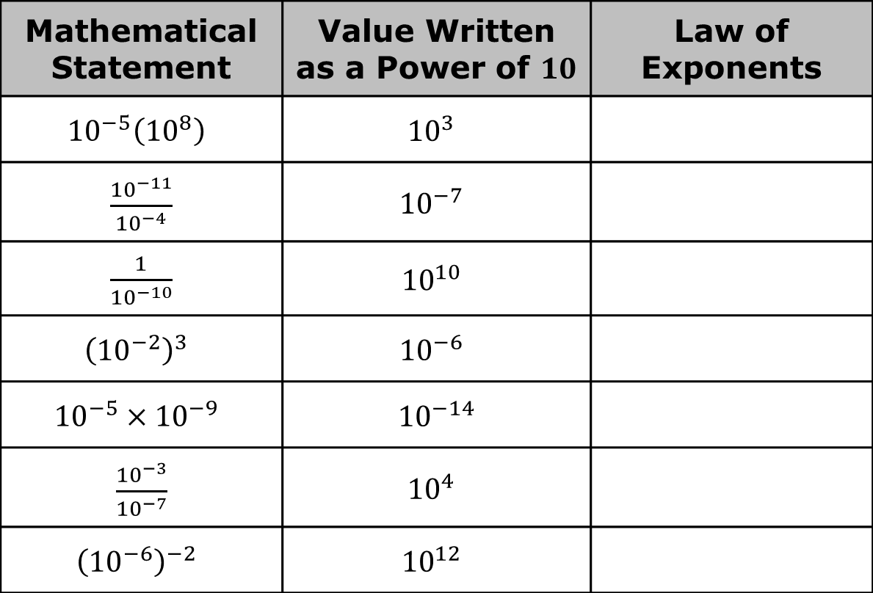
Use your findings to name the law of exponents used to rewrite each mathematical statement.
Mathematical Statement | Value Written as a Power of $10$ | Law of Exponents
$${10}^{−5}\left({10}^{8}\right)$$ | $${10}^{3}$$
$\frac{{10}^{−11}}{{10}^{−4}}$ | $${10}^{−7}$$
$\frac{1}{{10}^{−10}}$ | $${10}^{10}$$
$${\left({10}^{−2}\right)}^{3}$$ | $${10}^{−6}$$
$${10}^{−5}×{10}^{−9}$$ | $${10}^{−14}$$
$\frac{{10}^{−3}}{{10}^{−7}}$ | $${10}^{4}$$
$${\left({10}^{−6}\right)}^{−2}$$ | $${10}^{12}$$
volume 1, pg. 95

Slide 19

Guided Instruction
volume 1, pg. 96

Slide 20
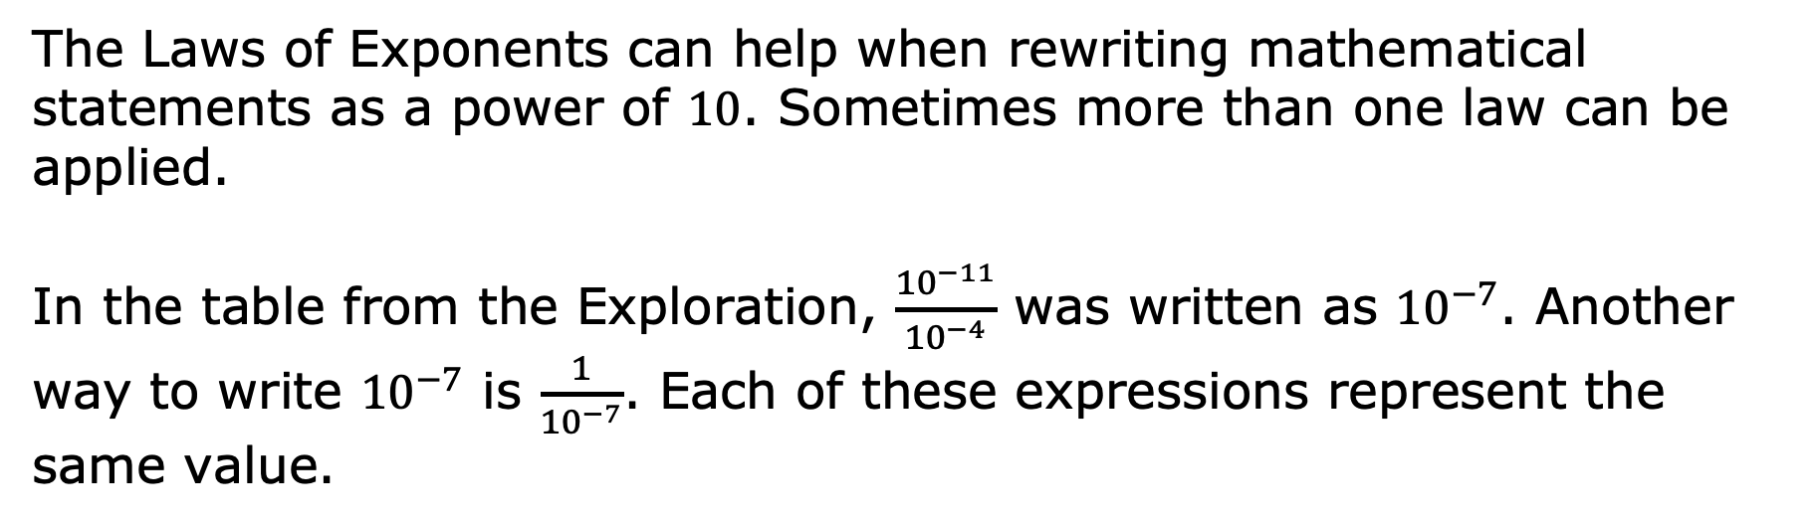
3.3.5 Guided Instruction: Applying the Laws of Exponents
The Laws of Exponents can help when rewriting mathematical statements as a power of $10$. Sometimes more than one law can be applied.
In the table from the Exploration, $\frac{{10}^{−11}}{{10}^{−4}}$ was written as ${10}^{−7}$. Another way to write ${10}^{−7}$ is $\frac{1}{{10}^{−7}}$. Each of these expressions represent the same value.
volume 1, pg. 96

Slide 21
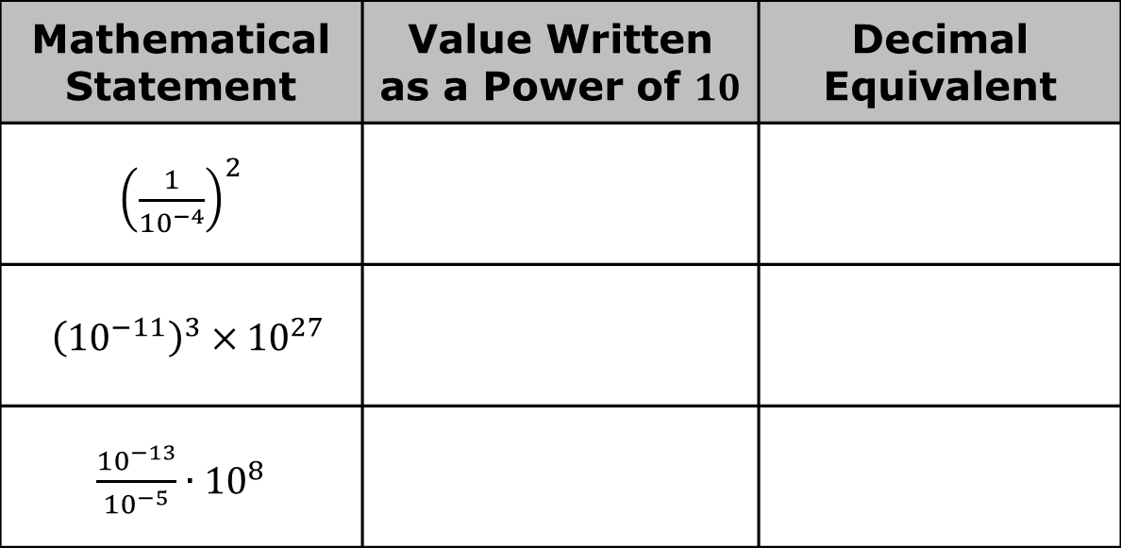
Write each mathematical statement in an equivalent form by applying one or more laws of exponents. Then, write the equivalent decimal value.
Mathematical Statement | Value Written as a Power of $10$ | Decimal Equivalent
${\left(\frac{1}{{10}^{−4}}\right)}^{2}$
${\left({10}^{−11}\right)}^{3}×{10}^{27}$
$\frac{{10}^{−13}}{{10}^{−5}}∙{10}^{8}$
volume 1, pg. 96

Slide 22
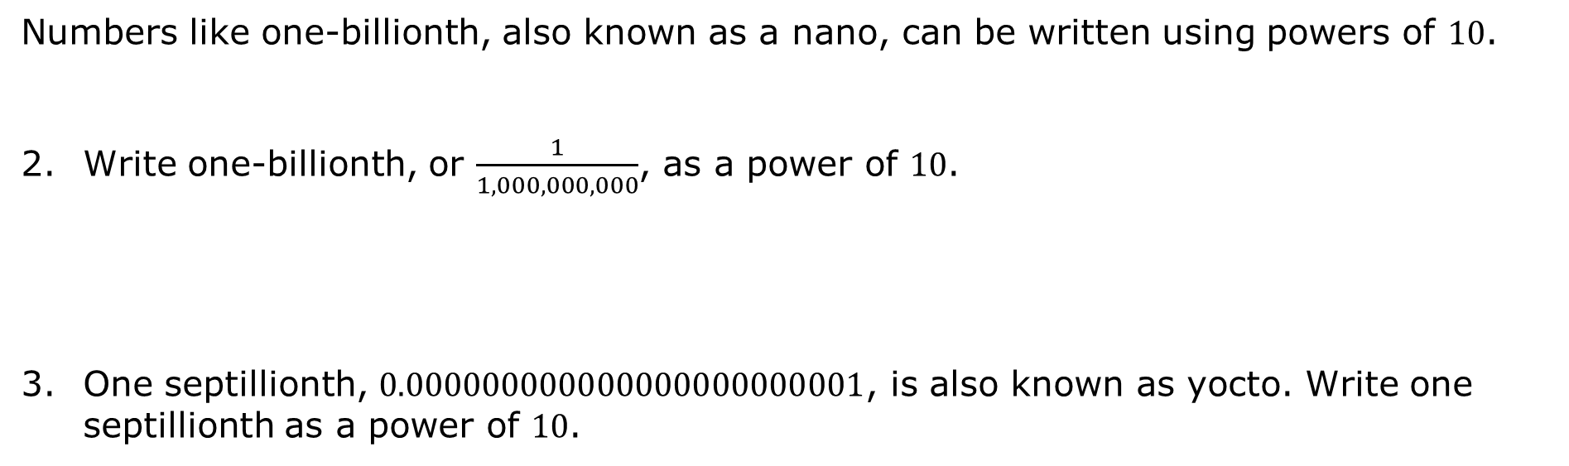
Numbers like one-billionth, also known as a nano, can be written using powers of $10$.
Write one-billionth, or $\frac{1}{1,000,000,000}$, as a power of $10$.
One septillionth, $0.000000000000000000000001$, is also known as yocto. Write one septillionth as a power of $10$.
volume 1, pg. 96

Slide 23

Wrap-Up
volume 1, pg. 97

Slide 24

3.3.6 Wrap-Up: Reflection
Complete the table as you reflect on today’s lesson.
Today I deserve a for …
volume 1, pg. 97

Slide 25

Today I was feeling about …
volume 1, pg. 97

